Slide 1
Planting Seeds of Knowledge
By:
Tyquaisha Ingram, Ivey Peteet,
Melissa Tindall,
and Mallory Walp

Slide 2
Essential Questions

Slide 3
Standards Addressed
Science: Plants: 1.L5.A.1 1.L5.A.2 1.L5.B.1 1.L5B.2 1.L5B.3 Inquiry: 1.S.1A.1/.2/.3/.4/.5 | Social Studies: Natural Resources: 1-1.3 1-1.4 Maps: 1-1.1 Goods and Services: 1-4.3 | ELA: Reading Informational Text: RI.5.1 RI5.2 RI8.2 Reading Literature Text: RL8.1 RL5.1 RL.7.1 Writing: W.2.1 W.2.2 | Mathematics: Geometry: 1.G.2 Data Analysis: 1.MDA.4 1.MDA.5 Measurement: 1.MDA.2 Number Sense: 1.NSBT.1 Patterns: 1.ATO.9

Slide 4
More Standards
Art Anchor Standard 2: Students will use different materials, techniques, and processes to make art. | Music Anchor Standard 4: Students will perform with technical accuracy and expression. | Technology Anchor Standard 1: Students can use technology tools, procedures, and processes to create a variety of media artworks in a safe and responsible manner. | Theatre Anchor Standard 1: Students will create scenes using story elements and structure.

Slide 5

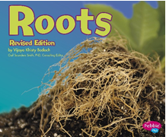

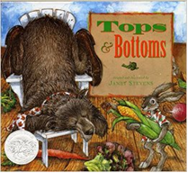


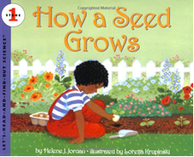
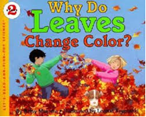
Great Read-Alouds

Slide 6
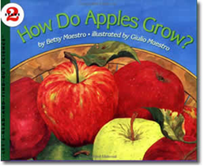
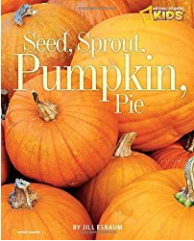
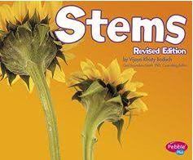
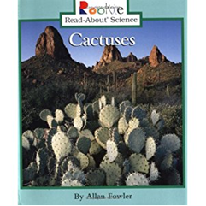
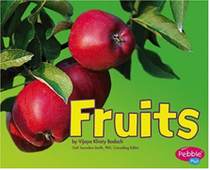
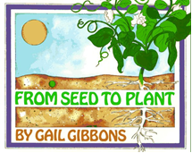
More Great
Read-Alouds

Slide 7
T.I.L.T Framework
Plant Structures (Week 1)
Plant Life Cycle (Week 2)
Plant Environment (Week 3)

Slide 8
Plant Structures
(Science)
Students will create flipbook on parts of the plant and its job.
Students will create an illustration on what plants need to survive.
Students will investigate what is inside a seed by dissecting a seed and recording observations.
Students will participate in a nature walk to find plant structures. Students will record findings in Science journals.
Create anchor charts to represent the different structures, plant needs, and types of plants.
Students will participate in a Stem investigation with colored water. Students will observe a plant change based on the color added to the water.

Slide 9
Plant Structures
(Arts Integration)
Students will create a 3-d structure of a flowering plant using craft materials.
Students will create a visual art based on “Tops and Bottoms” using watercolor.
Students will participate in a leaf rubbing activity.
Students will sing the parts of the plant song.

Slide 10
Plant Structures
(ELA)
Quick write: What do you know about plants?
Students will be placed into literature groups. Students will be given a plant to research. Students will create an informational writing on what the plant structures are and what jobs do they do.
Students will listen to a variety of non-fiction and fiction text. Students will retell texts read whole group about plant structures through graphic organizers.
Students will ask and answer questions about text read whole group about plants through graphic organizers.

Slide 11
Plant Structures
(ELA)
Small group: students will begin research project on their plant to identify the structures. Students will begin creating their non-fiction text booklet on their plant.
Students will find text and graphic features through non-fiction books about plants and record in a file-folder
Students will compare and contrast different structures of variety of plants through a Venn diagram.

Slide 12
Plant Structures
(Math)
Students will use two-dimensional shapes to create the parts of a plant. Students will use data of the types of shapes they used to create their plant and record in a tally chart. Students will use data to create various types of graphs. Students will analyze their data. Students will create an informational writing about the shapes they used to create their composite shape.

Slide 13
Plant Structures
(Social Studies)
Students will generate a list of different types of plants and the structures that are used for natural resources. (Food/Clothes/Materials)
Analyze and discuss how plant structures are used as goods and services in our community.

Slide 14
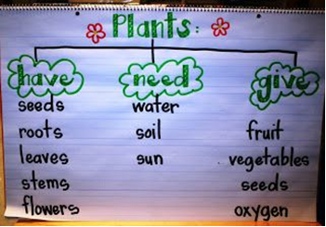
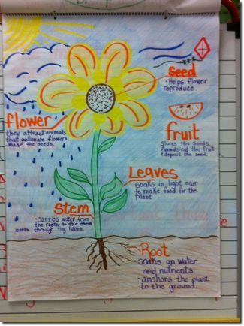
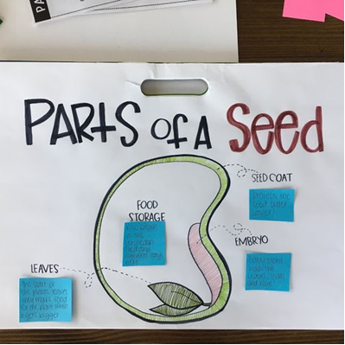
Anchor Charts

Slide 15
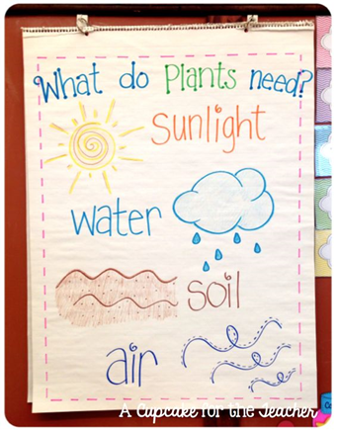
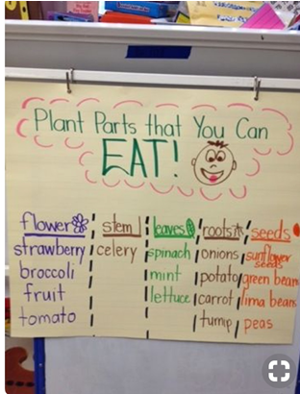
More Anchor Charts

Slide 16
Nonfiction Text Feature Folder Lesson
Developed by Melissa Tindall
RI 8.2: Students will be able to locate text features in a non-fiction plant book.

Slide 17
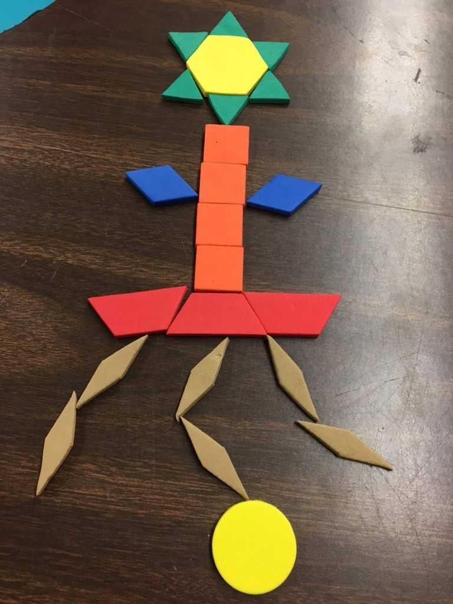
Plant Structures with Two-Dimensional shapes
Developed by: Mallory Walp
1.G.2: Students will combine two-dimensional shapes to create a composite shape.
1.MDA.4/5: Students will collect, organize, represent, and draw conclusions from data

Slide 18
Plant Life Cycle
(Science)
Students will complete the life-cycle unit booklet.
Create a lima-bean plant in a plastic bag taped to the window seal. Daily journal entries to record observations of the growth.
Students will create a visual life-cycle illustration through the paper plate activity

Slide 19
Plant Life Cycle
(Arts Integration)
Students will create a life-cycle of a flowering plant through craft materials.
Students will watch videos on the life-cycle of a flowering plant. Students will create movements to represent the different stages of development

Slide 20
Plant Life Cycle
(ELA)
Quick write: How do plants grow?
Small group: students will continue their research project on their plant to identify the different stages of its lifecycle. Students will add research to their text booklet.
Students will create an informational writing on the stages of their plant’s life-cycle.
Students will listen to a variety of non-fiction texts on different types of plants. Students will create Venn diagram comparing and contrasting the life-cycle of the different plants
Students will continue to find text and graphic features through non-fiction books about plants and record in their file-folder

Slide 21
Plant Life Cycle
(Math)
Create a ‘life-cycle’ of how a number can be written in multiple ways (number sense/place value)
Students will use non-standard units of measurement to measure the growth of their lima-bean plant throughout the unit.

Slide 22
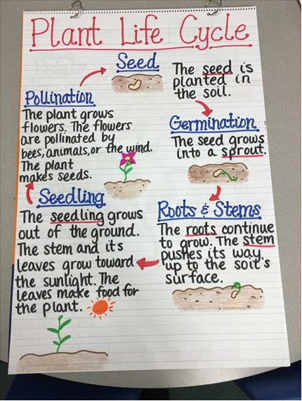
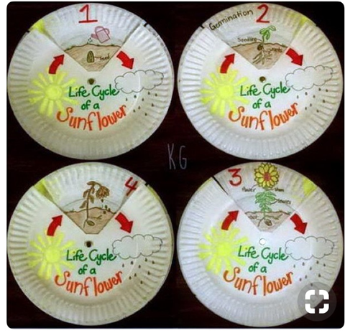
Anchor Charts

Slide 23
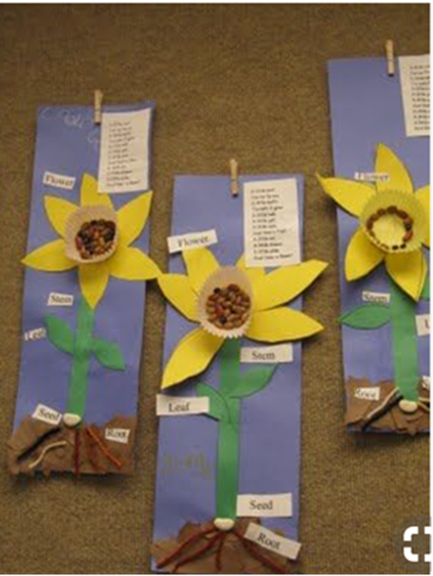
Plant Life Cycle
Developed by Tyquaisha Ingram
1.L.5A.1: I can identify the different plant structures and their jobs.

Slide 24
Environment
(Science)
Create anchor chart of plant adaptations and different environments (desert, forest, grassland)
Students will create a flipbook on the different characteristics of the environments.
Students will learn about plant adaptations through PowerPoint-‘Who would win?’
Students will complete plant adaption sort

Slide 25
Environment
(Arts Integration)
Students will create dioramas of the different environments and plants that thrive in those environments.
Students will watch videos on environments and plant adaptations.
Students will create a wordle on the computer using the different vocabulary terms they learned throughout the unit

Slide 26
Environment
(Math)
Students will create patterns using different colored seeds. ‘Plant a Pattern”
Students will use non-standard units of measurement to measure the growth of their lima-bean plant throughout the unit

Slide 27
Environment
(Social Studies)
Show students different models of food/plants from the different environments around the world.
Show students maps of where different environments are in the world and discuss the map characteristics.
Lesson on different foods that are produced around the world based on the plants’ environment
Students will listen to a variety of texts read aloud on different cultures around the world and their use of natural resources.

Slide 28
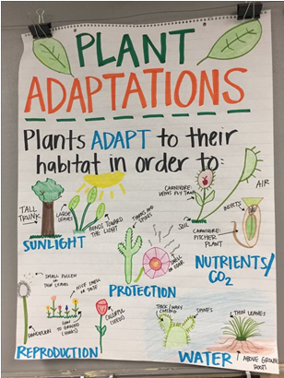
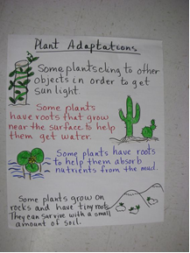
Anchor Charts

Slide 29
Natural Resources
Developed by Ivey Peteet
1-1.3:I can compare the ways that people use land and natural resources in different settings around the world.

Slide 30
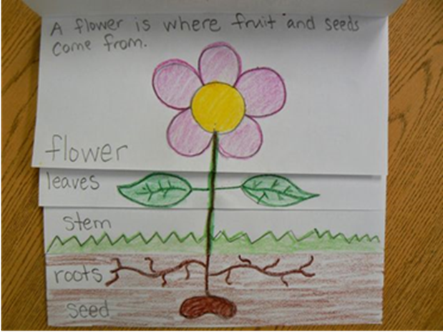
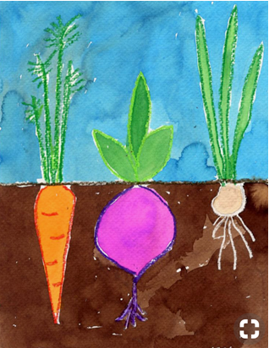
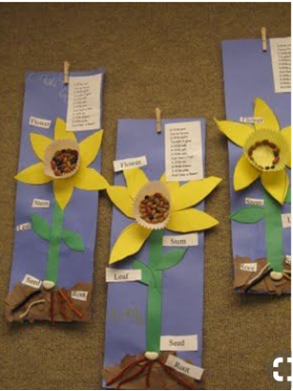
Final Products

Slide 31
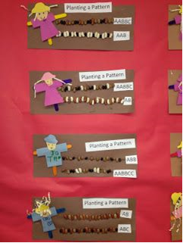
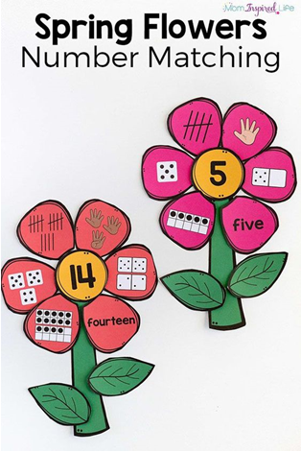
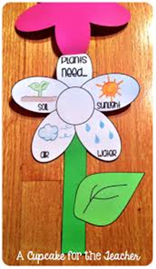
Final Products

Slide 32
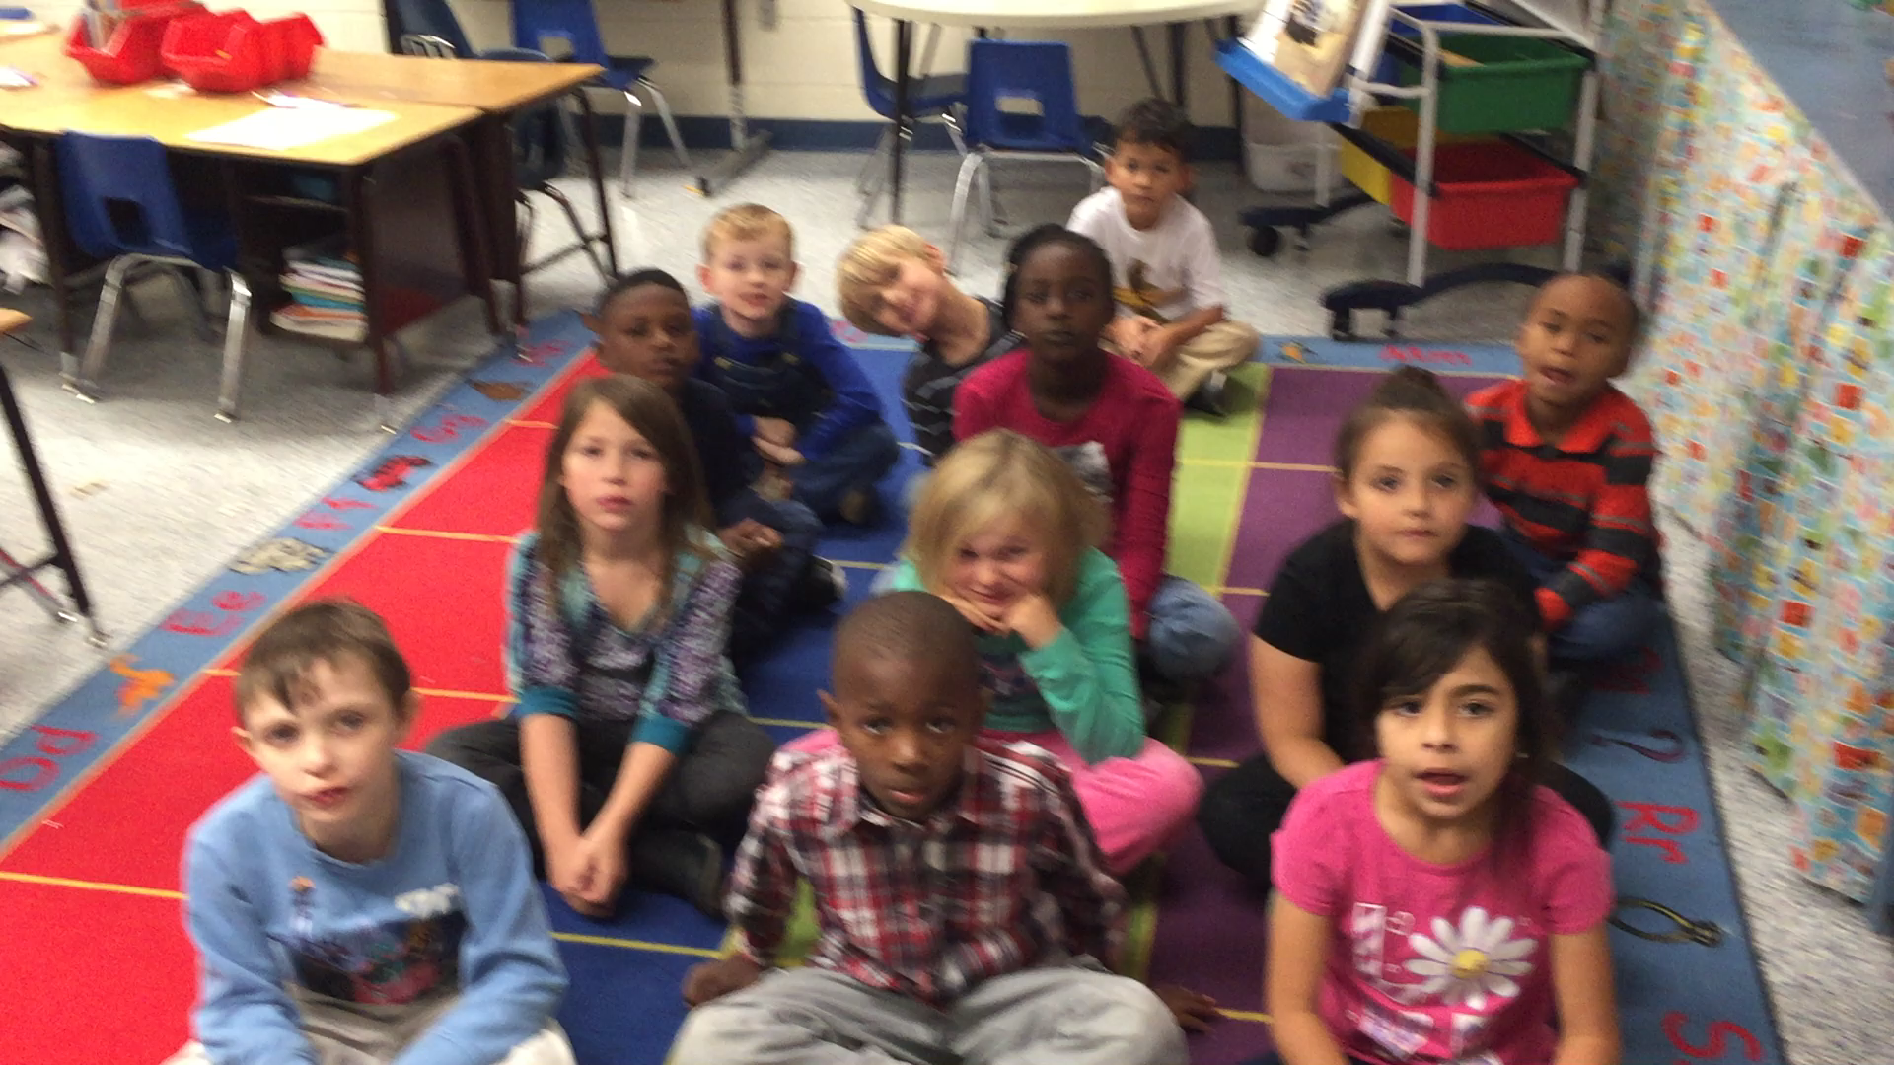
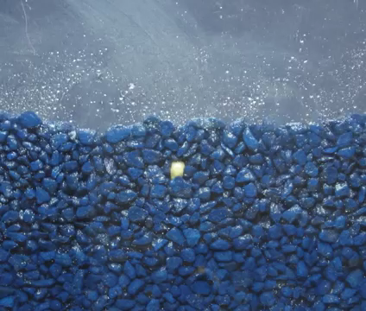
Thank You for supporting Aiken County Schools!!
Together…we can “Plant Seeds of Knowledge” for first graders!

